Slide 1
Branch & Bound
Reference https://fdocuments.in/document/branch-and-bound-design-and-analysis-of-alogorithm.html

Slide 2
TOPICS COVERED ARE:
Backtracking
Branch and bound
Divide and conquer
Greedy Methods
Short paths algorithms
‹#›
Notes:
‹#›

Slide 3
BRANCH AND BOUND
Branch and bound (BB) is a general algorithm for finding optimal solutions of various optimization problems, especially in discrete and combinatorial optimization. It consists of a systematic enumeration of all candidate solutions, where large subsets of fruitless candidates are discarded en masse (all together), by using upper and lower estimated bounds of the quantity being optimized.
‹#›
Notes:
‹#›

Slide 4
BRANCH AND BOUND
If we picture the subproblems graphically, then we form a search tree.
Each subproblem is linked to its parent and eventually to its children.
Eliminating a problem from further consideration is called pruning or fathoming.
The act of bounding and then branching is called processing.
A subproblem that has not yet been considered is called a candidate for processing.
The set of candidates for processing is called the candidate list.
Going back on the path from a node to its root is called backtracking.
‹#›
Notes:
‹#›

Slide 5
BACKTRACKING
Backtracking is a general algorithm for finding all (or some) solutions to some computational problem, that incrementally builds candidates to the solutions, and abandons each partial candidate ("backtracks") as soon as it determines that it cannot possibly be completed to a valid solution..
The Algorithm systematically searches for a solution to a problem among all available options. It does so by assuming that the solutions are represented by vectors (v₁, ..., v_{i}) of values and by traversing in a depth first manner the domains of the vectors until the solutions are found.
‹#›
Notes:
‹#›

Slide 6
BACKTRACKING
A systematic way to iterate through all the possible configurations of a search space.
Solution: a vector v = (v₁,v₂,…,v_{i})
At each step, we start from a given partial solution, say, v=(v₁,v₂,…,v_{k}), and try to extend it by adding another element at the end.
If so, we should count (or print,…) it.
If not, check whether possible extension exits.
If so, recur and continue
If not, delete v_{k} and try another possibility.
ALGORITHM try(v₁,...,v_{i})
IF (v₁,...,v_{i}) is a solution THEN RETURN (v₁,...,v_{i})
FOR each v DO IF (v₁,...,v_{i},v) is acceptable vector THEN sol = try(v1,...,vi,v) IF sol != () THEN RETURN sol
END
END
RETURN ()
‹#›

Slide 7
BACKTRACKING
The traversal of the solution space can be represented by a depth-first traversal of a tree. The tree itself is rarely entirely stored by the algorithm in discourse; instead just a path toward a root is stored, to enable the backtracking.
When you move forward on an x =1 branch, add to a variable that keeps track of the sum of the subset represented by the node. When you move back on an x = 1 branch, subtract. Moving in either direction along an x = 0 branch requires no add/subtract. When you reach a node with the desired sum, terminate. When you reach a node whose sum exceeds the desired sum, backtrack; do not move into this nodes subtrees. When you make a right child move see if the desired sum is attainable by adding in all remaining integers; for this keep another variable that gives you the sum of the remaining integers.
‹#›
Notes:
‹#›

Slide 8
BACKTRACKING DEPTH-FIRST SEARCH
x₁=1
x₁= 0
x₂=1
x₂= 0
x₂=1
x₂= 0
‹#›

Slide 9
BACKTRACKING DEPTH-FIRST SEARCH
x₁=1
x₁= 0
x₂=1
x₂= 0
x₂=1
x₂= 0
‹#›

Slide 10
BACKTRACKING DEPTH-FIRST SEARCH
x₁=1
x₁= 0
x₂=1
x₂= 0
x₂=1
x₂= 0
‹#›

Slide 11
BACKTRACKING DEPTH-FIRST SEARCH
x₁=1
x₁= 0
x₂=1
x₂= 0
x₂=1
x₂= 0
‹#›

Slide 12
BACKTRACKING DEPTH-FIRST SEARCH
x₁=1
x₁= 0
x₂=1
x₂= 0
x₂=1
x₂= 0
‹#›

Slide 13
BACKTRACKING DEPTH-FIRST SEARCH
x₁=1
x₁= 0
x₂=1
x₂= 0
x₂=1
x₂= 0
‹#›

Slide 14
GREEDY METHODS
A greedy algorithm:
is any algorithm that follows the problem solving metaheuristic of making the locally optimal choice at each stage with the hope of finding the global optimum.
A metaheuristic method:
Is method for solving a very general class of computational problems that aims on obtaining a more efficient or more robust procedure for the problem.
Generally it is applied to problems for which there is no satisfactory problem-specific algorithm designed to solve it.
It targeted to the combinatorial optimization (problems that’s are a problems in which has an optimization function to( minimize or maximize) subject to some constraints and its goal is to find the best possible solution
‹#›
Notes:
‹#›

Slide 15
EXAMPLES
The vehicle routing problem (VRP)
A number of goods need to be moved from certain pickup locations to other delivery locations. The goal is to find optimal routes for a fleet of vehicles to visit the pickup and drop-off locations.
Travelling salesman problem
Given a list of cities and their pair wise distances, the task is to find a shortest possible tour that visits each city exactly once.
Coin Change
(making change for n $ using minimum number of coins)
The knapsack problem
The Shortest Path Problem
‹#›

Slide 16
KNAPSACK
The knapsack problem or rucksack problem is a problem in combinatorial optimization. It derives its name from the following maximization problem of the best choice of essentials that can fit into one bag to be carried on a trip. Given a set of items, each with a weight and a value, determine the number of each item to include in a collection so that the total weight is less than a given limit and the total value is as large as possible.
‹#›
Notes:
‹#›

Slide 17
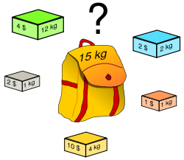
THE ORIGINAL KNAPSACK PROBLEM (1)
Problem Definition
Want to carry essential items in one bag
Given a set of items, each has
A cost (i.e., 12kg)
A value (i.e., 4$)
Goal
To determine the # of each item to include in a collection so that
The total cost is less than some given cost
And the total value is as large as possible
‹#›
Notes:
‹#›

Slide 18
THE ORIGINAL KNAPSACK PROBLEM (2)
Three Types
0/1 Knapsack Problem
restricts the number of each kind of item to zero or one
Bounded Knapsack Problem
restricts the number of each item to a specific value
Unbounded Knapsack Problem
places no bounds on the number of each item
Complexity Analysis
The general knapsack problem is known to be NP-hard
No polynomial-time algorithm is known for this problem
Here, we use greedy heuristics which cannot guarantee the optimal solution
‹#›
Notes:
‹#›

Slide 19




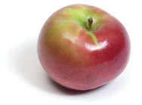
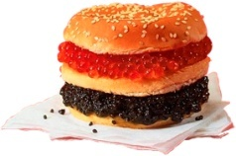
0/1 KNAPSACK PROBLEM (1)
Problem: John wishes to take n items on a trip
The weight of item i is w_{i} & items are all different (0/1 Knapsack Problem)
The items are to be carried in a knapsack whose weight capacity is c
When sum of item weights ≤ c, all n items can be carried in the knapsack
When sum of item weights > c, some items must be left behind
Which items should be taken/left?
‹#›
Notes:
‹#›

Slide 20
0/1 KNAPSACK PROBLEM (2)
John assigns a profit p_{i} to item i
All weights and profits are positive numbers
John wants to select a subset of the n items to take
The weight of the subset should not exceed the capacity of the knapsack (constraint)
Cannot select a fraction of an item (constraint)
The profit of the subset is the sum of the profits of the selected items (optimization function)
The profit of the selected subset should be maximum (optimization criterion)
Let x_{i} = 1 when item i is selected and x_{i} = 0 when item i is not selected
Because this is a 0/1 Knapsack Problem, you can choose the item or not choose it.
‹#›
Notes:
‹#›

Slide 21
GREEDY ATTEMPTS FOR 0/1 KNAPSACK
Apply greedy method:
Greedy attempt on capacity utilization
Greedy criterion: select items in increasing order of weight
When n = 2, c = 7, w = [3, 6], p = [2, 10], if only item 1 is selected 🡺 profit of selection is 2 🡺 not best selection!
Greedy attempt on profit earned
Greedy criterion: select items in decreasing order of profit
When n = 3, c = 7, w = [7, 3, 2], p = [10, 8, 6], if only item 1 is selected 🡺 profit of selection is 10 🡺 not best selection!
‹#›
Notes:
‹#›

Slide 22
THE SHORTEST PATH PROBLEM
Path length is sum of weights of edges on path in directed weighted graph
The vertex at which the path begins is the source vertex
The vertex at which the path ends is the destination vertex
Goal
To find a path between two vertices such that the sum of the weights of its edges is minimized
‹#›
Notes:
‹#›

Slide 23
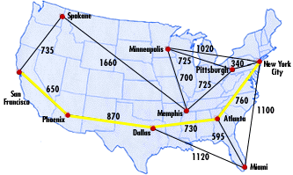
TYPES OF THE SHORTEST PATH PROBLEM
Three types
Single-source single-destination shortest path
Single-source all-destinations shortest path
All pairs (every vertex is a source and destination) shortest path
‹#›
Notes:
‹#›

Slide 24
N-Queens Problem

Slide 25
N-Queens Problem
N - Queens problem is to place n - queens in such a manner on an n x n chessboard that no queens attack each other by being in the same row, column or diagonal.
It can be seen that for n =1, the problem has a trivial solution, and no solution exists for n =2 and n =3. So first we will consider the 4 queens problem and then generate it to n - queens problem.
Given a 4 x 4 chessboard and number the rows and column of the chessboard 1 through 4.

Slide 26
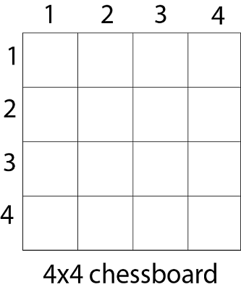
N-Queens Problem

Slide 27
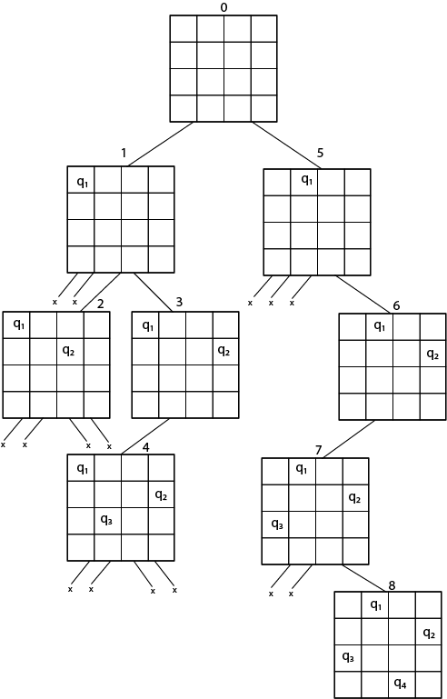

Slide 28
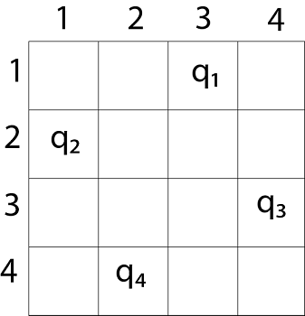
N-Queens Problem

Slide 29
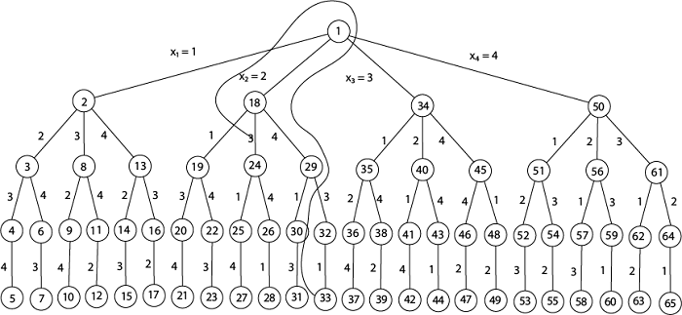
4 - Queens solution space with nodes numbered in DFS

Slide 30
Subset-Sum Problem

Slide 31
Introduction - Subset-Sum Problem
The Subset-Sum Problem is to find a subset's' of the given set S = (S₁ S₂ S₃...S_{n}) where the elements of the set S are n positive integers in such a manner that s'∈S and sum of the elements of subset's' is equal to some positive integer 'X.‘
The Subset-Sum Problem can be solved by using the backtracking approach. In this implicit tree is a binary tree.
The root of the tree is selected in such a way that represents that no decision is yet taken on any input.
Assume that the elements of the given set are arranged in increasing order:

Slide 32
Subset-Sum Problem
The left child of the root node indicated that we have to include 'S₁' from the set 'S' and the right child of the root indicates that we have to exclude 'S₁'.
Each node stores the total of the partial solution elements. If at any stage the sum equals to 'X' then the search is successful and terminates.

Slide 33
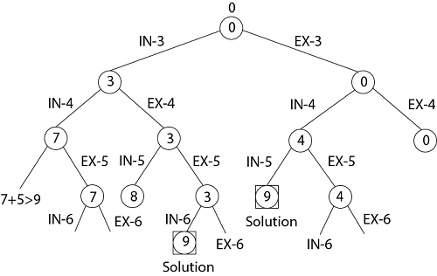
Example: Given a set S = (3, 4, 5, 6) and X =9. Obtain the subset sum using Backtracking approach.
Initially S = (3, 4, 5, 6) and X =9.
S'= (∅)
The implicit binary tree for the subset sum problem is shown as fig:

Slide 34
Hamiltonian Circuit Problems
Given a graph G = (V, E) we have to find the Hamiltonian Circuit using Backtracking approach.
We start our search from any arbitrary vertex say 'a.‘
This vertex 'a' becomes the root of our implicit tree.
The first element of our partial solution is the first intermediate vertex of the Hamiltonian Cycle that is to be constructed.
The next adjacent vertex is selected by alphabetical order.
If at any stage any arbitrary vertex makes a cycle with any vertex other than vertex 'a' then we say that dead end is reached.
In this case, we backtrack one step, and again the search begins by selecting another vertex and backtrack the element from the partial; solution must be removed.
The search using backtracking is successful if a Hamiltonian Cycle is obtained.

Slide 35
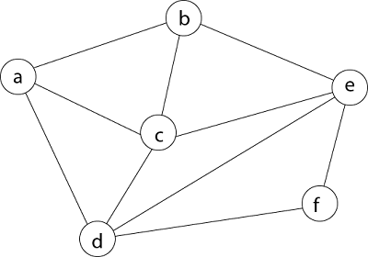
Example: Consider a graph G = (V, E) shown in fig. we have to find a Hamiltonian circuit using Backtracking method.

Slide 36
Hamiltonian Circuit Problems
The number inside a node is the sum of the partial solution elements at a particular level.
Thus, if our partial solution elements sum is equal to the positive integer 'X' then at that time search will terminate, or it continues if all the possible solution needs to be obtained.

Slide 37
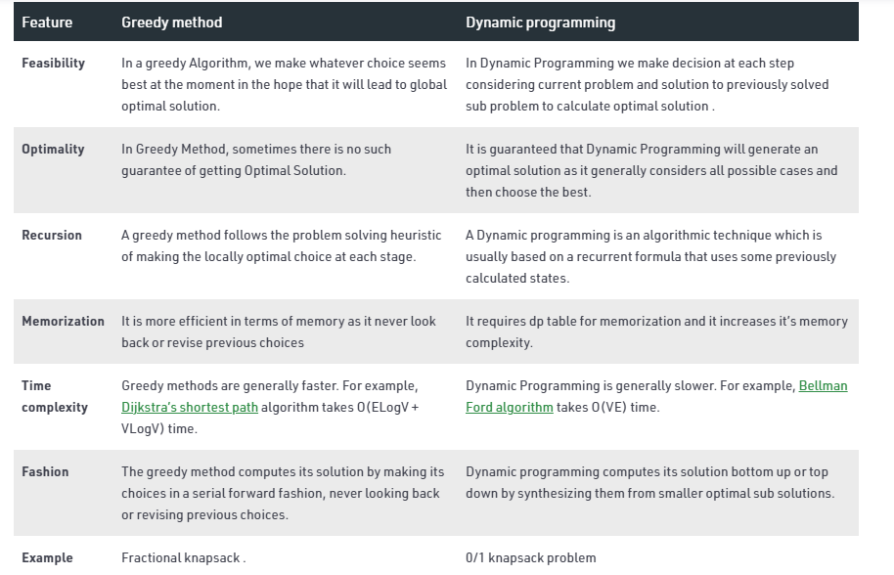
Greedy method and Dynamic programming

Slide 38
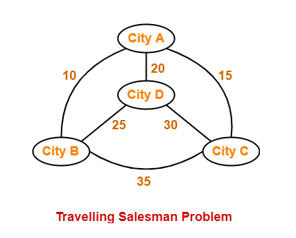
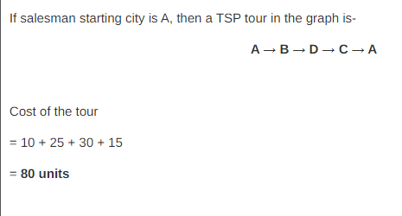
Travelling Salesman problem

Slide 39
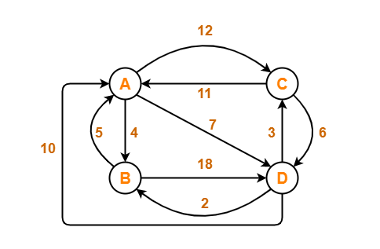
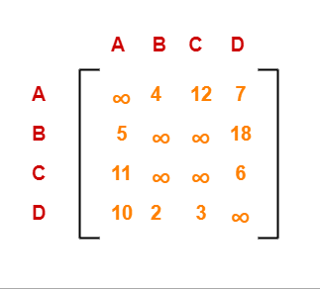
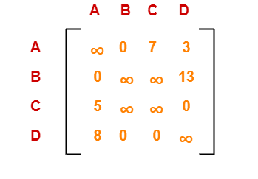
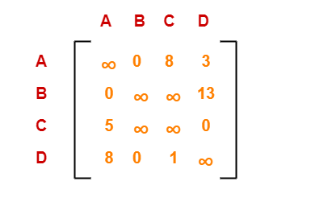
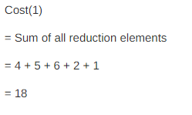
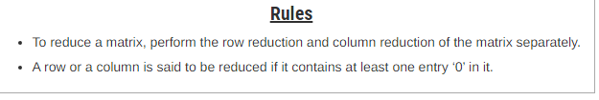
Step-01:
Row Reduction-
Column Reduction-c

Slide 40
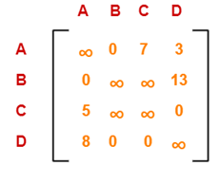
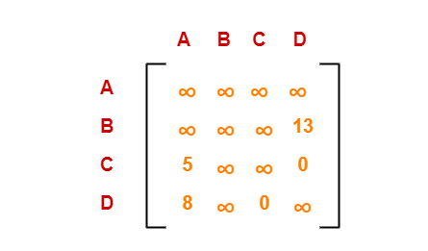
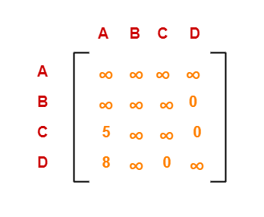
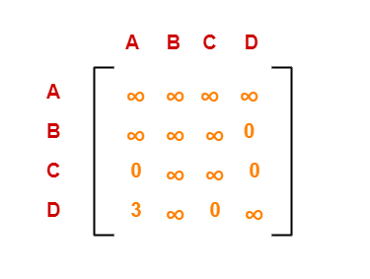
Step-02:
Choosing To Go To Vertex-B: Node-2 (Path A → B)
Row Reduction-
Column Reduction-c
Cost(2)
= Cost(1) + Sum of reduction elements + M[A,B]
= 18 + (13 + 5) + 0
= 36

Slide 41
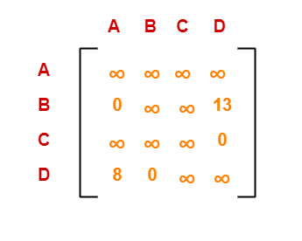
Choosing To Go To Vertex-C: Node-3 (Path A → C)
= Cost(1) + Sum of reduction elements + M[A,C]
= 18 + 0 + 7
= 25
Row Reduction-

Slide 42
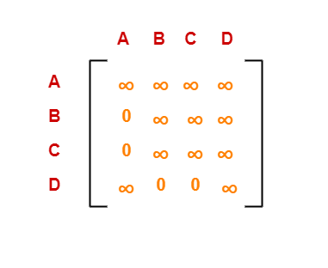
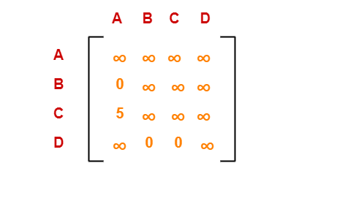
Choosing To Go To Vertex-D: Node-4 (Path A → D)
Row Reduction-
Cost(4)
= Cost(1) + Sum of reduction elements + M[A,D]
= 18 + 5 + 3
= 26

Slide 43
Travelling Salesman problem
Cost(2) = 36 (for Path A → B)
Cost(3) = 25 (for Path A → C)
Cost(4) = 26 (for Path A → D)
we choose node-3 i.e. path A → C.

Slide 44
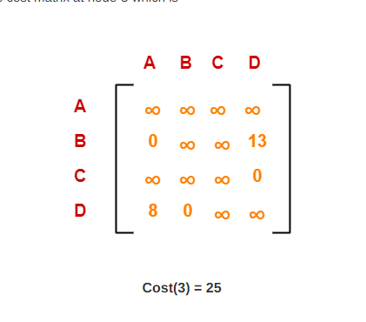
Step-03:

Slide 45
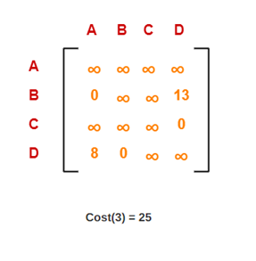
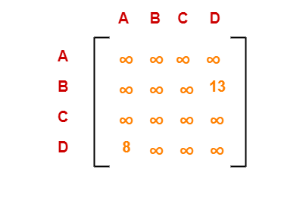
Choosing To Go To Vertex-B: Node-5 (Path A → C → B)
From the reduced matrix of step-02, M[C,B] = ∞
Set row-C and column-B to ∞
Set M[B,A] = ∞
Now, resulting cost matrix is-

Slide 46
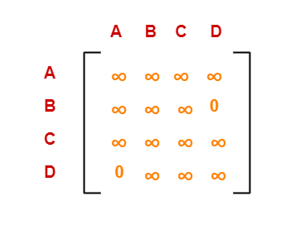
Travelling Salesman problem
Row Reduction-
Column Reduction-
Cost(5)
= cost(3) + Sum of reduction elements + M[C,B]
= 25 + (13 + 8) + ∞
= ∞

Slide 47
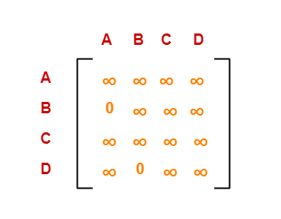
Choosing To Go To Vertex-D: Node-6 (Path A → C → D)
From the reduced matrix of step-02, M[C,D] = 0
Set row-C and column-D to ∞
Set M[D,A] = ∞
Row Reduction-
Cost(6)
= cost(3) + Sum of reduction elements + M[C,D]
= 25 + 0 + 0
= 25

Slide 48
Travelling Salesman problem
Cost(5) = ∞ (for Path A → C → B)
Cost(6) = 25 (for Path A → C → D)
we choose node-6 i.e. path C → D.

Slide 49
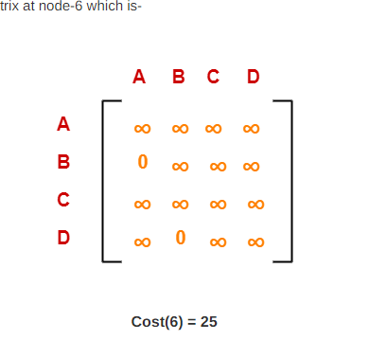
Step-04:

Slide 50
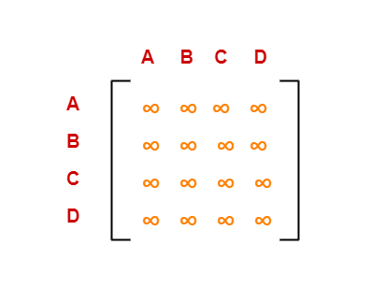
Choosing To Go To Vertex-B: Node-7 (Path A → C → D → B)
From the reduced matrix of step-03, M[D,B] = 0
Set row-D and column-B to ∞
Set M[B,A] = ∞
Cost(7)
= cost(6) + Sum of reduction elements + M[D,B]
= 25 + 0 + 0

Slide 51
Travelling Salesman problem
Optimal path is: A → C → D → B → A
Cost of Optimal path = 25 units

Slide 52
Floyd Warshall Algorithm-
https://www.gatevidyalay.com/floyd-warshall-algorithm-shortest-path-algorithm/

Slide 53
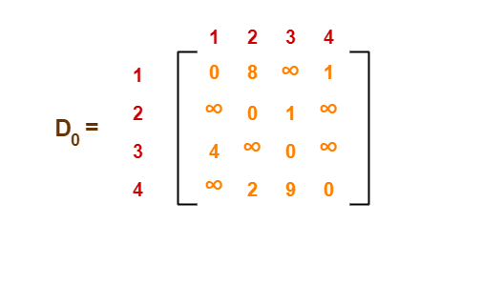
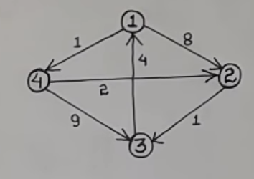
Floyd Warshall Algorithm-
https://www.youtube.com/watch?v=eujc7_0FhCI

Slide 54
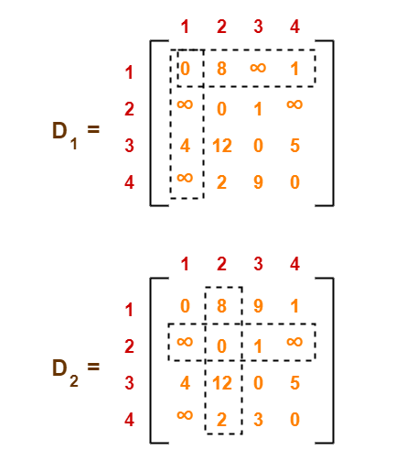
Floyd Warshall Algorithm-

Slide 55
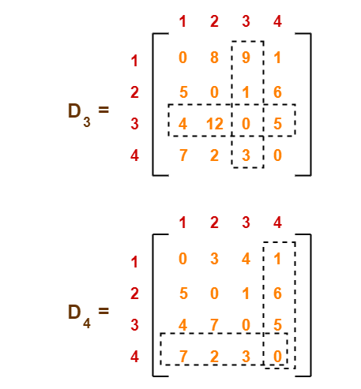
Floyd Warshall Algorithm-

Slide 56
Graphs
BFS & DFS

Slide 57
Basic Terminology
Representation
Search
BFS & DFS

Slide 58
Introduction
A graph G is simply a set V of vertices and a collection E of pairs of vertices from V, called edges.
Some books use different terminology for graphs and refer to what we call vertices as nodes and what we call edges as arcs.

Slide 59
Edges in a graph are either directed or undirected.
An edge (u,v) is said to be directed from u to v if the pair (u,v) is ordered, with u preceding v.
An edge (u,v) is said to be undirected if the pair (u,v) is not ordered.
Undirected edges are sometimes denoted with set notation, as {u,v}, but for simplicity we use the pair notation (u,v), noting that in the undirected case (u,v) is the same as (v,u).

Slide 60
If all the edges in a graph are undirected, then we say the graph is an undirected graph.
a directed graph, also called a digraph, is a graph whose edges are all directed.
A graph that has both directed and undirected edges is often called a mixed graph.

Slide 61
vertices
1
2
3
5
4
2
Edges
1
5
3
Directed Edge
4

Slide 62
The two vertices joined by an edge are called the end vertices (or endpoints) of the edge.
If an edge is directed, its first endpoint is its origin and the other is the destination of the edge.
Two vertices u and v are said to be adjacent if there is an edge whose end vertices are u and v.
An edge is said to be incident on a vertex if the vertex is one of the edge’s endpoints.
The outgoing edges of a vertex are the directed edges whose origin is that vertex. The incoming edges of a vertex are the directed edges whose destination is that vertex.

Slide 63
adjacent
1
2
3
Incoming
Edges 2
5
4
2
Incident 3
1
5
3
Outgoing Edges 2
4

Slide 64
The degree of a vertex v, denoted deg(v), is the number of incident edges of v. The in-degree and out-degree of a vertex v are the number of the incoming and outgoing edges of v, and are denoted indeg(v) and outdeg(v), respectively.
Degree of 3 is 3
2
1
In Degree of 3 is 2
5
3
Out Degree of 3 is 1
Degree of 4 is 2
4
In Degree of 4 is 1

Slide 65
Allowing for two undirected edges to have the same end vertices, and for two directed edges to have the same origin and the same destination. Such edges are called parallel edges or multiple edges.
e3
A
e4
B
e5
e2
e1
D
C

Slide 66
An edge (undirected or directed) is a self-loop if its two endpoints coincide
A graphs do not have parallel edges or self-loops such graphs are said to be simple.
A path is a sequence of alternating vertices and edges that starts at a vertex and ends at a vertex such that each edge is incident to its predecessor and successor vertex.

Slide 67
e2
e3
self-loop
A
e4
B
e5
e1
D
C
A
B
simple
D
C

Slide 68
Graph Representation
1. Adjacency Matrix
2. Incidence Matrix
3. Adjacency List

Slide 69
1. Adjacency Matrix
A
B
C
D
A
0
1
0
1
A
B
B
1
0
1
1
C
0
1
0
1
D
C
D
1
1
1
1

Slide 70
1. Adjacency Matrix
A
B
C
D
A
0
1
0
1
A
B
B
0
0
1
1
C
0
0
0
0
D
C
D
0
0
1
1

Slide 71
2. Incidence Matrix
e1
e2
e3
e4
e5
e1
A
1
1
0
0
0
A
B
B
-1
0
1
0
1
e3
e5
e2
C
0
0
0
-1
-1
e4
D
C
D
0
-1
-1
1
0

Slide 72
2. Adjacency List
A
B D
A
B
B
C D
C
C
D
D
C D

Slide 73
2. Adjacency List
A
B D
A
B
B
D
C
A B D
D
D
C
A

Slide 74
3. Adjacency List
A
B
C
D
A
B
D
B
D
C
A
B
D
D
A

Slide 75
BFS
A
B
C
D
E
F
G
H
I
A
D
E
B
G
C
F
H
I

Slide 76
Result of BFS
A
B
C
D
E
F
G
H
I

Slide 77
BFS
http://www.btechsmartclass.com/data_structures/graph-traversal-bfs.html
https://www.youtube.com/watch?v=pcKY4hjDrxk

Slide 78
DFS
A
B
C
D
E
F
I
E
H
G
C
F
G
H
I
D
B
A

Slide 79
DFS
http://www.btechsmartclass.com/data_structures/graph-traversal-dfs.html

Slide 80

Floyd Warshall Algorithm-
https://www.youtube.com/watch?v=eujc7_0FhCI

Slide 81
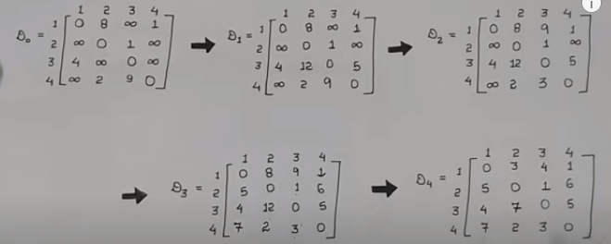

Slide 82
BFS & DFS
https://www.youtube.com/watch?v=pcKY4hjDrxk

